Slide 1
Chapter 10 Basic GUI Programming Using Tkinter

Slide 2
Motivations
Tkinter is not only a useful tool for developing GUI projects, but also a valuable pedagogical tool for learning object-oriented programming.
+ Comes by default in the Python package.
Other GUI Options:
PyQt5
Kivy
wxPython
PyGUI
… et al.

Slide 3
Objectives
To create a simple GUI application with Tkinter (§10.2).
To process events by using callback functions that are bound to a widget’s command option (§10.3).
To use labels, entries, buttons, check buttons, radio buttons, messages, and text to create graphical user interfaces (§10.4).
To draw lines, rectangles, ovals, polygons, and arcs and display text strings in a canvas (§10.5).
To use geometry managers to lay out widgets in a container (§10.6).
To lay out widgets in a grid by using the grid manager (§10.6.1).
To pack widgets side by side or on top of each other by using the pack manager (§10.6.2).
To place widgets in absolute locations by using the place manager (§10.6.3).
To write a GUI loan calculator (§10.7).
To write a GUI program for checking a Sudoku solution (§10.8).
To use images in widgets (§10.9).
To write a GUI program that displays the images of four cards (§10.9).

Slide 4
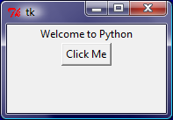
Getting Started with Tkinter
Getting started with Tkinter with a simple example.
SimpleGUI
# Listing 10.1 SimpleGUI.py
from tkinter import * # Import tkinter
root_window = Tk() # Create a root window
myLabel = Label(root_window, text = "Welcome to Python") # Create a label
myButton = Button(root_window, text = "Click Me") # Create a button
myLabel.pack() # Display the label in the window
myButton.pack() # Display the button in the window
root_window.mainloop() # Create an event loop

Slide 5
Minimum Tkinter GUI Program Template
import tkinter
root_window = tkinter.Tk()
# define widgets in root_window
# define handlers for events
# display the widgets
# go into the main event loop:
root_window.mainloop() # accept input, process, update GUI

Slide 6
# Tkinter simple test
import tkinter
root_window = tkinter.Tk()
root_window.mainloop()

Slide 7

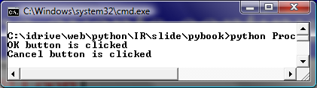
Processing Events
window.mainloop() # Create an event loop
The statement creates an event loop. The event loop processes the events continuously.
# Listing 10.2 ProcessButtonEvent.py
from tkinter import * # Import tkinter
def processOK():
print("OK button is clicked")
def processCancel():
print("Cancel button is clicked")
root_window = Tk() # Create a root window
btOK = Button(root_window, text = "OK", fg = "red",
command = processOK) # Invoke processOK when OK button is clicked
btCancel = Button(root_window, text = "Cancel", bg = "yellow",
command = processCancel)
btOK.pack() # Place the button in the window
btCancel.pack() # Place the button in the window
root_window.mainloop() # Create an event loop
ProcessButtonEvent

Slide 8
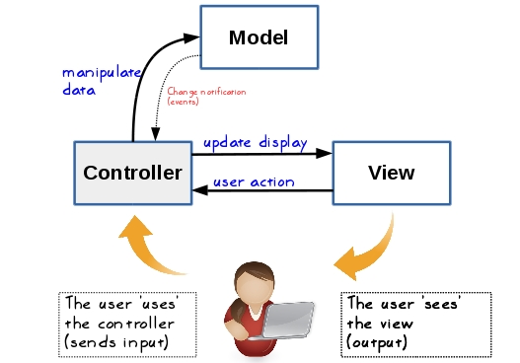
MVC: Model View Controller Pattern

Slide 9
General OO Pattern for GUI
from tkinter import *
class MyGUI
def __init__(self):
root_window = Tk() # Create a root window
my_widget1 = WidgetClassName(root_window, <<properties>>)
my_widget2 = WidgetClassName(root_window, <<properties>>)
# possibly other widgets
my_widget1.pack() # or grid() or place()
my_widget2.pack() # or grid() or place()
root_window.mainloop() # main evet loop
def processEvent1(self)
def processEvent2(self)
my_gui = MyGUI() # instantiate an object of MYGUI class

Slide 10
The Widget Classes

Slide 11
Color and Font
To specify a color, you can either use a color name such as red, yellow, green, blue, white, black, purple, etc, or explicitly specify the red, green, and blue (RGB) color components using a string #RRGGBB, where RR, GG, BB are hexadecimal representations of the red, green and blue values, respectively.
"Times 10 bold"
"Helvetica 10 bold italic"
"Courier New 20 bold italic"
"Courier New 20 bold italic over strike underline"

Slide 12
Text Formatting
The text in a label and a button is centered by default. You can change it by using the justify option with values LEFT, CENTER, or RIGHT. You can also display the text in multiple lines by inserting the newline character \n to separate texts.

Slide 13
Mouse Cursor
You can set a mouse cursor by using the cursor option with values such as "arrow" (default), "circle", "cross" "plus", etc.

Slide 14
Change Properties
widgetName["propertyName"] = newPropertyValue
btShowOrHide = Button(window, text = "Show", bg = "white")
btShowOrHide["text"] = "Hide"
btShowOrHide["bg"] = "red"
btShowOrHide["fg"] = "#AB84F9" # Change fg color to #AB84F9
btShowOrHide["cursor"] = "plus" # Change mouse cursor to plus

Slide 15
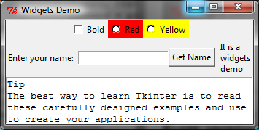
Widget Demo
WidgetsDemo

Slide 16
# Listing 10.4 WidgetsDemo.py page 1/3
from tkinter import * # Import tkinter
class WidgetsDemo:
def __init__(self):
window = Tk() # Create a window
window.title("Widgets Demo") # Set a title
# Add a button, a check button, and a radio button to frame1
frame1 = Frame(window) # Create and add a frame to window
frame1.pack()
self.v1 = IntVar() # Create an IntVar bound with cbtBold
cbtBold = Checkbutton(frame1, text = "Bold",
variable = self.v1, command = self.processCheckbutton)
self.v2 = IntVar() # Create an IntVar bound with rbRed
rbRed = Radiobutton(frame1, text = "Red", bg = "red",
variable = self.v2, value = 1,
command = self.processRadiobutton)
rbYellow = Radiobutton(frame1, text = "Yellow",
bg = "yellow", variable = self.v2, value = 2,
command = self.processRadiobutton)
cbtBold.grid(row = 1, column = 1)
rbRed.grid(row = 1, column = 2)
rbYellow.grid(row = 1, column = 3)

Slide 17
# Listing 10.4 WidgetsDemo.py 2/3
# Add a button, a check button, and a radio button to frame1
frame2 = Frame(window) # Create and add a frame to window
frame2.pack()
label = Label(frame2, text = "Enter your name: ")
self.name = StringVar() # Create a StringVar bound with entryName
entryName = Entry(frame2, textvariable = self.name)
btGetName = Button(frame2, text = "Get Name",
command = self.processButton)
message = Message(frame2, text = "It is a widgets demo")
label.grid(row = 1, column = 1)
entryName.grid(row = 1, column = 2)
btGetName.grid(row = 1, column = 3)
message.grid(row = 1, column = 4)
# Add a text
text = Text(window) # Create a text add to the window
text.pack()
text.insert(END,
"Tip\nThe best way to learn Tkinter is to read ")
text.insert(END,
"these carefully designed examples and use them ")
text.insert(END, "to create your applications.")
window.mainloop() # Create an event loop

Slide 18
# Listing 10.4 WidgetsDemo.py 3/3
def processCheckbutton(self):
print("check button is "
+ ("checked " if self.v1.get() == 1 else "unchecked"))
def processRadiobutton(self):
print(("Red" if self.v2.get() == 1 else "Yellow")
+ " is selected " )
def processButton(self):
print("Your name is " + self.name.get())
WidgetsDemo() # Create GUI

Slide 19
Canvas
Canvas can be used to display shapes. You can use the method such as create_rectangle, create_oval, create_arc, create_polygon, and create_line to draw a rectangle, oval, arc, polygon, and line on a canvas.

Slide 20
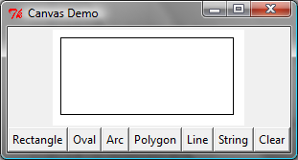
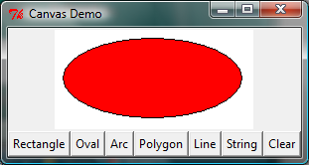
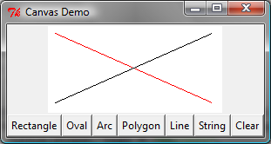
Canvas Demo
CanvasDemo

Slide 21
Drawing Methods

Slide 22
# Listing 10.6 CanvasDemo.py 1/3
from tkinter import *
class CanvasDemo:
def __init__(self):
window = Tk() # Create a window
window.title("Canvas Demo") # Set title
# Place self.canvas in the window
self.canvas = Canvas(window, width = 200, height = 100,
bg = "white")
self.canvas.pack()
# Place buttons in frame
frame = Frame(window)
frame.pack()
btRectangle = Button(frame, text = "Rectangle",
command = self.displayRect) # Call displayRect
btOval = Button(frame, text = "Oval",
command = self.displayOval)
btArc = Button(frame, text = "Arc",
command = self.displayArc)
btPolygon = Button(frame, text = "Polygon",
command = self.displayPolygon)
btLine = Button(frame, text = "Line",
command = self.displayLine)
btString = Button(frame, text = "String",
command = self.displayString)
btClear = Button(frame, text = "Clear",
command = self.clearCanvas)

Slide 23
# Listing 10.6 CanvasDemo.py 2/3
btRectangle.grid(row = 1, column = 1)
btOval.grid(row = 1, column = 2)
btArc.grid(row = 1, column = 3)
btPolygon.grid(row = 1, column = 4)
btLine.grid(row = 1, column = 5)
btString.grid(row = 1, column = 6)
btClear.grid(row = 1, column = 7)
window.mainloop() # Create an event loop
# Display a rectangle
def displayRect(self):
self.canvas.create_rectangle(10, 10, 190, 90, tags = "rect")
# Display an oval
def displayOval(self):
self.canvas.create_oval(10, 10, 190, 90, fill = "red",
tags = "oval")
# Display an arc
def displayArc(self):
self.canvas.create_arc(10, 10, 190, 90, start = 0,
extent = 90, width = 8, fill = "red", tags = "arc")
# Display a polygon
def displayPolygon(self):
self.canvas.create_polygon(10, 10, 190, 90, 30, 50,
tags = "polygon")

Slide 24
# Listing 10.6 CanvasDemo.py 3/3
# Display a line
def displayLine(self):
self.canvas.create_line(10, 10, 190, 90, fill = "red",
tags = "line")
self.canvas.create_line(10, 90, 190, 10, width = 9,
arrow = "last", activefill = "blue", tags = "line")
# Display a string
def displayString(self):
self.canvas.create_text(60, 40, text = "Hi, I am a string",
font = "Times 10 bold underline", tags = "string")
# Clear drawings
def clearCanvas(self):
self.canvas.delete("rect", "oval", "arc", "polygon",
"line", "string")
CanvasDemo() # Create GUI

Slide 25
Geometry Managers
Grid Manager
Pack Manager
Place Manager
Since each manager has its own style of placing the widget, it is not a good practice to mix the managers for the widgets in the same container. You can use a frame as a subcontainer to achieve desired layout.

Slide 26
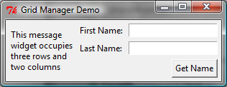
Grid Manager
GridManagerDemo

Slide 27
# Listing 10.7 GridManagerDemo.py
from tkinter import * # Import tkinter
class GridManagerDemo:
window = Tk() # Create a window
window.title("Grid Manager Demo") # Set title
message = Message(window, text =
"This Message widget occupies three rows and two columns")
message.grid(row = 1, column = 1, rowspan = 3, columnspan = 2)
Label(window, text = "First Name:").grid(row = 1, column = 3)
Entry(window).grid(row = 1, column = 4, padx = 5, pady = 5)
Label(window, text = "Last Name:").grid(row = 2, column = 3)
Entry(window).grid(row = 2, column = 4)
Button(window, text = "Get Name").grid(row = 3,
padx = 5, pady = 5, column = 4, sticky = E)
window.mainloop() # Create an event loop
GridManagerDemo() # Create GUI

Slide 28
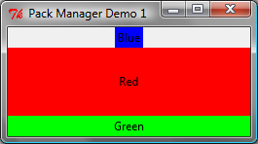
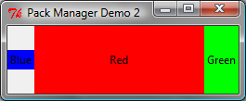
Pack Manager
PackManagerDemo1
PackManagerDemo2

Slide 29
# Listing 10.8 PackManagerDemo.py
from tkinter import * # Import tkinter
class PackManagerDemo:
def __init__(self):
window = Tk() # Create a window
window.title("Pack Manager Demo 1") # Set title
Label(window, text = "Blue", bg = "blue").pack()
Label(window, text = "Red", bg = "red").pack(
fill = BOTH, expand = 1)
Label(window, text = "Green", bg = "green").pack(
fill = BOTH)
window.mainloop() # Create an event loop
PackManagerDemo() # Create GUI
#Listing 10.9 PackManagerDemoWithSide
from tkinter import * # Import tkinter
class PackManagerDemoWithSide:
window = Tk() # Create a window
window.title("Pack Manager Demo 2") # Set title
Label(window, text = "Blue", bg = "blue").pack(side = LEFT)
Label(window, text = "Red", bg = "red").pack(
side = LEFT, fill = BOTH, expand = 1)
Label(window, text = "Green", bg = "green").pack(
side = LEFT, fill = BOTH)
window.mainloop() # Create an event loop
PackManagerDemoWithSide() # Create GUI

Slide 30
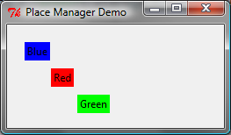
Place Manager
PlaceManagerDemo

Slide 31
# Listing 10.10 PlaceManagerDemo.py
from tkinter import * # Import tkinter
class PlaceManagerDemo:
def __init__(self):
window = Tk() # Create a window
window.title("Place Manager Demo") # Set title
Label(window, text = "Blue", bg = "blue") \
.place(x = 20, y = 20) # Place the label at (20, 20)
Label(window, text = "Red", bg = "red").place(
x = 50, y = 50)
Label(window, text = "Green", bg = "green").place(
x = 80, y = 80)
window.mainloop() # Create an event loop
PlaceManagerDemo() # Create GUI

Slide 32
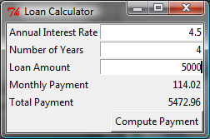
Case Study: Loan Calculator
LoanCalculator

Slide 33
# Listing 10.11 LoanCalculator.py 1/3
from tkinter import * # Import tkinter
class LoanCalculator:
def __init__(self):
window = Tk() # Create a window
window.title("Loan Calculator") # Set title
Label(window, text = "Annual Interest Rate").grid(row = 1,
column = 1, sticky = W)
Label(window, text = "Number of Years").grid(row = 2,
column = 1, sticky = W)
Label(window, text = "Loan Amount").grid(row = 3,
column = 1, sticky = W)
Label(window, text = "Monthly Payment").grid(row = 4,
column = 1, sticky = W)
Label(window, text = "Total Payment").grid(row = 5,
column = 1, sticky = W)

Slide 34
# Listing 10.11 LoanCalculator.py 2/3
self.annualInterestRateVar = StringVar()
Entry(window, textvariable = self.annualInterestRateVar,
justify = RIGHT).grid(row = 1, column = 2)
self.numberOfYearsVar = StringVar()
Entry(window, textvariable = self.numberOfYearsVar,
justify = RIGHT).grid(row = 2, column = 2)
self.loanAmountVar = StringVar()
Entry(window, textvariable = self.loanAmountVar,
justify = RIGHT).grid(row = 3, column = 2)
self.monthlyPaymentVar = StringVar()
lblMonthlyPayment = Label(window, textvariable =
self.monthlyPaymentVar).grid(row = 4, column = 2,
sticky = E)
self.totalPaymentVar = StringVar()
lblTotalPayment = Label(window, textvariable =
self.totalPaymentVar).grid(row = 5,
column = 2, sticky = E)
btComputePayment = Button(window, text = "Compute Payment",
command = self.computePayment).grid(
row = 6, column = 2, sticky = E)
window.mainloop() # Create an event loop

Slide 35
# Listing 10.11 LoanCalculator.py 3/3
def computePayment(self):
monthlyPayment = self.getMonthlyPayment(
float(self.loanAmountVar.get()),
float(self.annualInterestRateVar.get()) / 1200,
int(self.numberOfYearsVar.get()))
self.monthlyPaymentVar.set(format(monthlyPayment, '10.2f'))
totalPayment = float(self.monthlyPaymentVar.get()) * 12 \
* int(self.numberOfYearsVar.get())
self.totalPaymentVar.set(format(totalPayment, '10.2f'))
def getMonthlyPayment(self,
loanAmount, monthlyInterestRate, numberOfYears):
monthlyPayment = loanAmount * monthlyInterestRate / (1
- 1 / (1 + monthlyInterestRate) ** (numberOfYears * 12))
return monthlyPayment;
LoanCalculator() # Create GUI

Slide 36
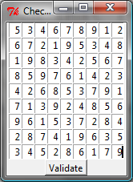
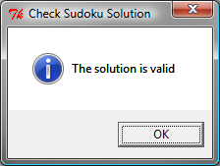
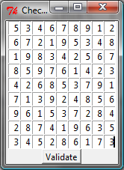
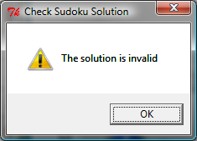
Sudoku GUI
SudokuGUI

Slide 37
Display Images
You can add an image in a label, button, check button, and radio button. To create an image, use the PhotoImage class as follows:
photo = PhotoImage(file = imagefilename)
The image file must be GIF. You can use a conversion utility to convert image files in other format into GIF.

Slide 38
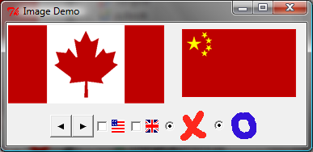
Image Example
ImageDemo

Slide 39
# Listing 10.13 ImageDemo.py 1/2
from tkinter import * # Import tkinter
class ImageDemo:
def __init__(self):
window = Tk() # Create a window
window.title("Image Demo") # Set title
# Create image objects
caImage = PhotoImage(file = "image/ca.gif")
chinaImage = PhotoImage(file = "image/china.gif")
leftImage = PhotoImage(file = "image/left.gif")
rightImage = PhotoImage(file = "image/right.gif")
usImage = PhotoImage(file = "image/usIcon.gif")
ukImage = PhotoImage(file = "image/ukIcon.gif")
crossImage = PhotoImage(file = "image/x.gif")
circleImage = PhotoImage(file = "image/o.gif")
# frame1 to contain label and canvas
frame1 = Frame(window)
frame1.pack()
Label(frame1, image = caImage).pack(side = LEFT)
canvas = Canvas(frame1)
canvas.create_image(90, 50, image = chinaImage)
canvas["width"] = 200
canvas["height"] = 100
canvas.pack(side = LEFT)

Slide 40
# Listing 10.13 ImageDemo.py 2/2
# frame2 to contain buttons, check buttons, and radio buttons
frame2 = Frame(window)
frame2.pack()
Button(frame2, image = leftImage).pack(side = LEFT)
Button(frame2, image = rightImage).pack(side = LEFT)
Checkbutton(frame2, image = usImage).pack(side = LEFT)
Checkbutton(frame2, image = ukImage).pack(side = LEFT) # Checkbutton for ukImage
Radiobutton(frame2, image = crossImage).pack(side = LEFT)
Radiobutton(frame2, image = circleImage).pack(side = LEFT)
window.mainloop() # Create an event loop
ImageDemo() # Create GUI

Slide 41
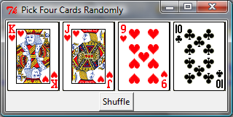
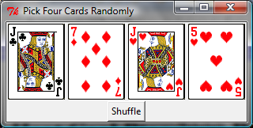
Deck of Cards GUI
DeckOfCardsGUI

Slide 42
# Listing 10.14 DeckOfCardsGUI.py
import random
class DeckOfCardsGUI:
def __init__(self):
window = Tk() # Create a window
window.title("Pick Four Cards Randomly") # Set title
self.imageList = [] # Store images for cards
for i in range(1, 53): # i from 1 to 52
self.imageList.append(PhotoImage(file = "image/card/"
+ str(i) + ".gif")) # Add PhotoImage to the list
frame = Frame(window) # Hold four labels for cards
frame.pack()
self.labelList = [] # A list of four labels
for i in range(4):
self.labelList.append(Label(frame,
image = self.imageList[i])) # Use imageList[i]
self.labelList[i].pack(side = LEFT)
Button(window, text = "Shuffle",
command = self.shuffle).pack() # Perform shuffle
window.mainloop() # Create an event loop
# Choose four random cards
def shuffle(self):
random.shuffle(self.imageList)
for i in range(4):
self.labelList[i]["image"] = self.imageList[i]
DeckOfCardsGUI() # Create GUI

